Slide 1
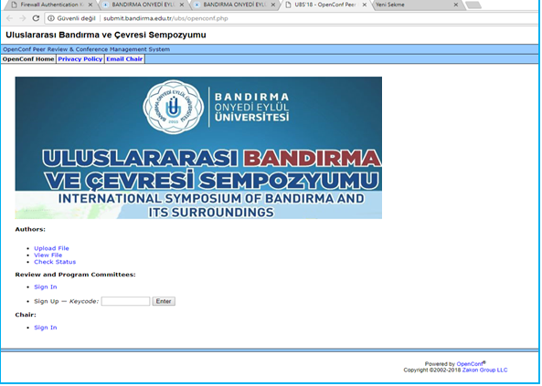
Fulltext Submission system presentation

Slide 2
The procedure to be followed:
1. Registering over the Submission System and getting an ID number and password for each paper.
2. Sending / uploading the abstracts until 28th July 2019.
3. Completing the evaluation of the papers by the Scientific Committee until 31th July 2019 and replying to the researches whether their paper(s) is accepted or refused until 1st August 2019.
4. Uploading the full text of the paper into the system using ID number and password between 2nd August and 26th August 2019 after getting a reply that the paper has been accepted.
5. Announcing the list of the full texts of the papers have been accepted by the Scientific Committee until 31st August 2018.
6. Announcing the Symposium Program on 8th September 2018.
Step by step Paper Submission:

Slide 3
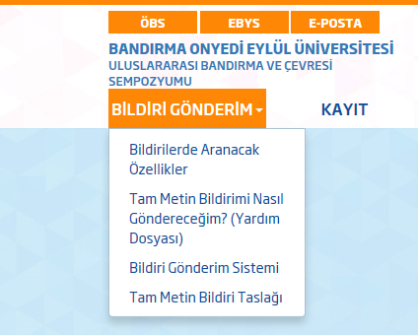
Before preparing your paper, please refer to ‘ Paper Requirements’ and ‘Fulltext Template’ given under the «Submission»

Slide 4
Click on ‘Paper Submission’ to send your fulltext paper.

Slide 5
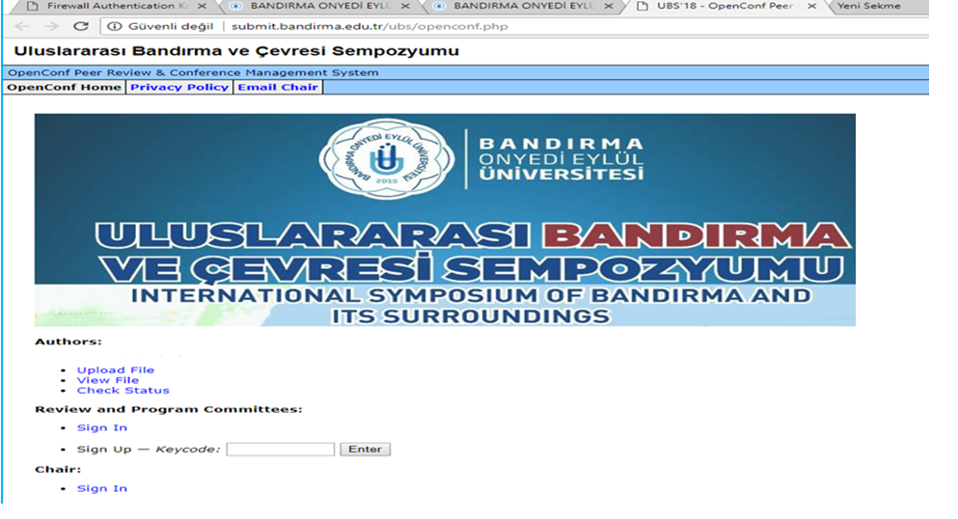
Please, click «Upload File» to send your paper.

Slide 6
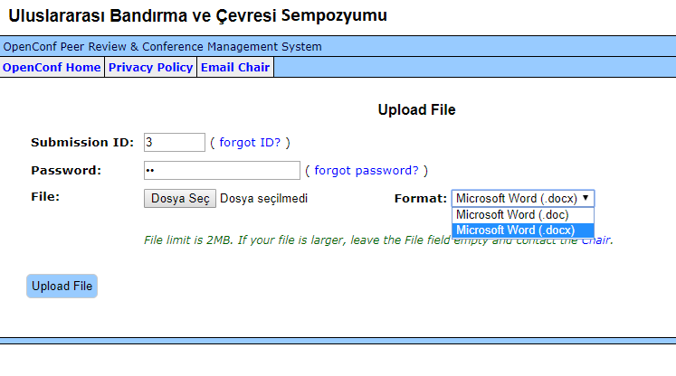
Write your ID number in “Submission ID” part. (If you have forgotten your ID number, click the link “forgot ID?” or find “accepted abstracts” in your mailbox)
Write your password in “Password” part. (If you have forgotten your password, click “forgot password?” link or mail to us (please write your ID and “I forgot my password”)

Slide 7
Clicking the link “Dosya Seç-Choose a file”, upload your fulltext prepared beforehand according to the draft given in this site. You can only upload one MS Office Word document here. Other document formats aren’t accepted.
In “Format” part, choose Microsoft Word (.doc) or (.docx) format according to your own document format.
Click “Upload File” button.

Slide 8
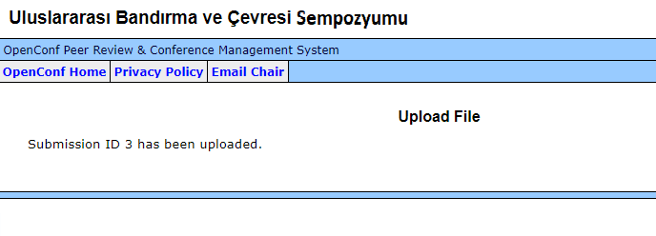
If you see “Submission ID .. has been uploaded”, it means your submission is completed successfully.
Pay Attention, Please!!!
If you want to send another paper, it is required to follow all the steps described above from the beginning again. The system records every abstract with a different ID number.

Slide 9
To review your abstract after submission,
click “View File” link.

Slide 10
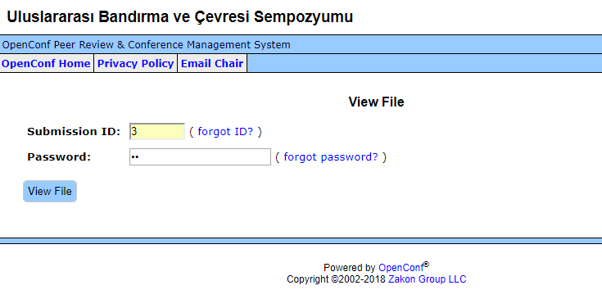
To view the fulltext of the paper you have uploaded into the system, enter your ID number and password.
Click on “View File”.

Slide 11
To view the status of the paper you have uploaded, click on “Check Status” .

Slide 12
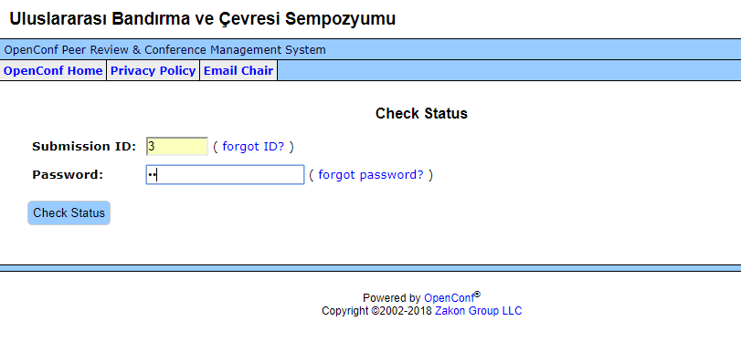
To view the status of the paper you have uploaded into the system, enter your ID use name and password.
Click on “Check Status”.

